Slide 1
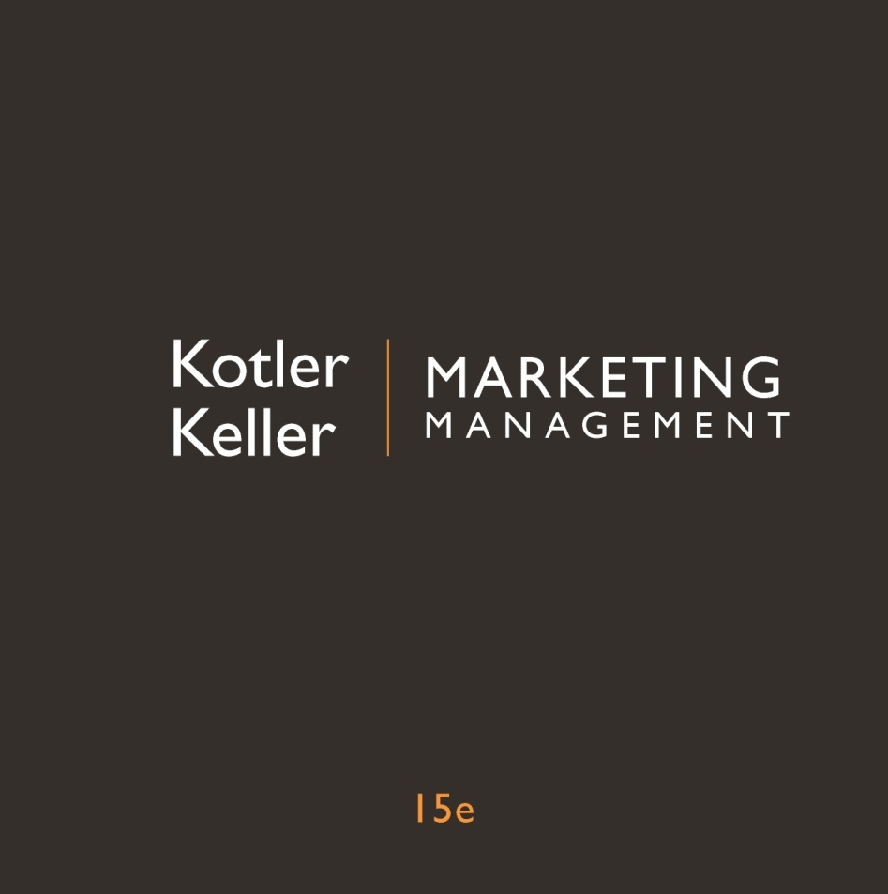
Chapter
7
Analyzing
Business Markets

Slide 2

Learning Objectives
What is organizational buying?
What buying situations do business buyers face?
Who participates in the business-to-business buying process?
How do business buyers make their decisions?
In what ways can business-to-business companies develop effective marketing programs?
How can companies build strong loyalty relationships with business customers?
How do institutional buyers and government agencies do their buying?

Slide 3


What is
Organizational Buying?
Business market
  Consists of all the organizations that acquire goods and services used in the production of other products or services that are sold, rented, or supplied to others
Notes:
Frederick E. Webster Jr. and Yoram Wind define organizational buying as the decision-making process by which formal organizations establish the need for purchased products and services and identify, evaluate, and choose among alternative brands and suppliers. Any firm that supplies components for products is in the business-to-business marketplace. More dollars and items change hands in sales to business buyers than to consumers.

Slide 4
Business markets
Fewer, larger buyers
Close supplier–customer relationships
Professional purchasing
Multiple buying influences
Multiple sales calls
Derived demand
Inelastic demand
Fluctuating demand
Geographically concentrated buyers
Direct purchasing
Notes:
Business marketers contrast sharply with consumer markets in some ways. The business marketer normally deals with far fewer, much larger buyers than the consumer marketer does, particularly in such industries as aircraft engines and defense weapons. Because of the smaller customer base and the importance and power of the larger customers, suppliers are frequently expected to customize their offerings to individual business customer needs. Business goods are often purchased by trained purchasing agents, who must follow their organizations’ purchasing policies, constraints, and requirements. More people typically influence business buying decisions. Buying committees consisting of technical experts and even senior management are common in the purchase of major goods. A study by McGraw-Hill found that it took four to four-and-a-half calls to close an average industrial sale. The demand for business goods is ultimately derived from the demand for consumer goods. The total demand for many business goods and services is inelastic—that is, not much affected by price changes. The demand for business goods and services tends to be more volatile than the demand for consumer goods and services. The geographical concentration of producers helps to reduce selling costs. Business buyers often buy directly from manufacturers rather than through intermediaries, especially items that are technically complex or expensive such as mainframes or aircraft.

Slide 5
Buying situations
Straight Rebuy
Modified Rebuy
New Task
Notes:
In a straight rebuy, the purchasing department reorders items like office supplies and bulk chemicals on a routine basis and chooses from suppliers on an approved list. The suppliers make an effort to maintain product and service quality and often propose automatic reordering systems to save time. “Out suppliers” attempt to offer something new or exploit dissatisfaction with a current supplier. Their goal is to get a small order and then enlarge their purchase share over time.
The buyer in a modified rebuy wants to change product specifications, prices, delivery requirements, or other terms. This usually requires additional participants on both sides. The in-suppliers become nervous and want to protect the account. The out-suppliers see an opportunity to propose a better offer to gain some business.
New task. A new-task purchaser buys a product or service for the first time (an office building, a new security system). The greater the cost or risk, the larger the number of participants, and the greater their information gathering—the longer the time to a decision.

Slide 6
The buying center
  Initiators
  Users
Influencers
Deciders
Approvers
Buyers
Gatekeepers
Notes:
Webster and Wind call the decision-making unit of a buying organization the buying center. It consists of “all those individuals and groups who participate in the purchasing decision-making process, who share some common goals and the risks arising from the decisions.” The buying center includes all members of the organization who play any of seven roles in the purchase decision process.
1. Initiators—Users or others in the organization who request that something be purchased.
2. Users—Those who will use the product or service. In many cases, the users initiate the buying proposal and help define the product requirements.
3. Influencers—People who influence the buying decision, often by helping define specifications and providing information for evaluating alternatives. Technical people are particularly important influencers.
4. Deciders—People who decide on product requirements or on suppliers.
5. Approvers—People who authorize the proposed actions of deciders or buyers.
6. Buyers—People who have formal authority to select the supplier and arrange the purchase terms. Buyers may help shape product specifications, but they play their major role in selecting vendors and negotiating. In more complex purchases, buyers might include high-level managers.
7. Gatekeepers—People who have the power to prevent sellers or information from reaching members of the
buying center. For example, purchasing agents, receptionists, and telephone operators may prevent salespersons from contacting users or deciders.

Slide 7
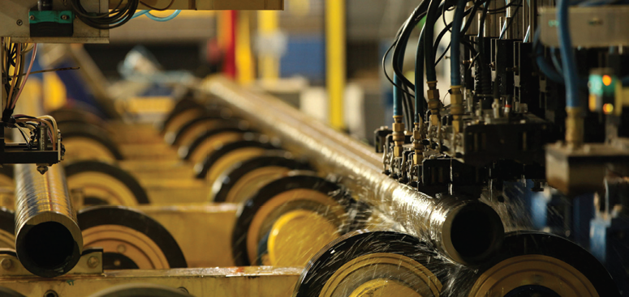
Targeting within the Business Center
Who are the major decision participants?
What decisions do they influence, and how deeply?
What evaluation criteria do they use?
Notes:
Once it has identified the type of businesses on which to focus marketing efforts, the firm must then decide how best to sell to them. The business marketer is not likely to know exactly what kind of group dynamics take place during the decision process, though whatever information he or she can obtain about personalities and interpersonal factors is useful.

Slide 8

The Purchasing/
Procurement Process
Business buyers seek the highest benefit package (economic, technical, service, and social) in relationship to a market offering’s costs

Slide 9
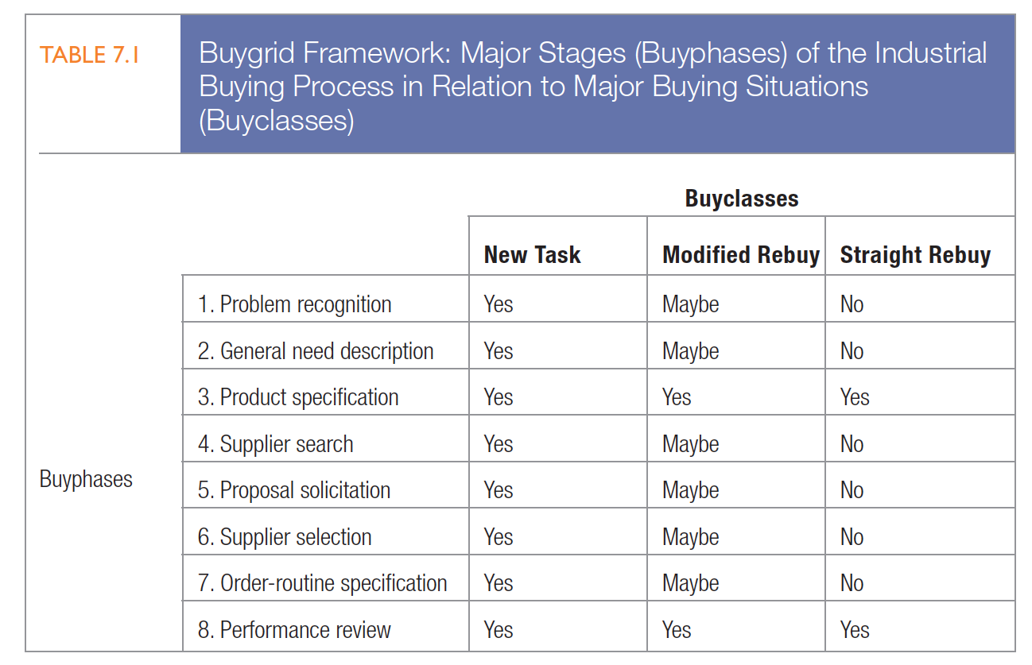
Stages in the Buying Process
Notes:
The model in Table 7.1 is the buygrid framework

Slide 10
Stages in the Buying Process
Problem recognition
  Someone in the company recognizes a problem or need that can be met by acquiring a good or service
General need description and product specification
  Next, the buyer determines the needed item’s general characteristics, required quantity, and technical specifications
Notes:
The recognition can be triggered by internal or external stimuli. The internal stimulus might be a decision to develop a new product that requires new equipment and materials or a machine that breaks down and requires new parts. Or purchased material turns out to be unsatisfactory and the company searches for another supplier or lower prices or better quality.
Often, the company will assign a product-value-analysis engineering team to the project. Product value analysis (PVA) is an approach to cost reduction that studies whether components can be redesigned or standardized or made by cheaper methods of production without adversely affecting product performance.

Slide 11
Stages in the Buying Process
Supplier search
Catalog sites
Vertical markets
Buying alliances
“Pure Play” auction
Private exchanges
Spot & barter markets
Notes:
The buyer next tries to identify the most appropriate suppliers through trade directories, contacts with other companies, trade advertisements, trade shows, and the Internet. The move to online purchasing has far-reaching implications for suppliers and will change the shape of purchasing for years to come. Companies that purchase online are utilizing electronic marketplaces in several forms listed on this slide.
Catalog sites. Companies can order thousands of items through electronic catalogs, such as W. W. Grainger’s, distributed by e-procurement software.
Vertical markets. Companies buying industrial products such as plastics, steel, or chemicals or services such as logistics or media can go to specialized Web sites called e-hubs. Plastics.com allows plastics buyers to search the best prices among thousands of plastics sellers.
“Pure Play” auction company. Ritchie Bros. Auctioneers is the world’s largest industrial auctioneer, with 44 auction sites worldwide. It sold $3.8 billion of used and unused equipment at more than 356 unreserved auctions in 2013, including a wide range of heavy equipment, trucks, and other assets for the construction, transportation, agricultural, material handling, oil and gas, mining, forestry, and marine industry sectors. While some people prefer to bid in person at Ritchie Bros. auctions, they can also do so online in real time at rbauction.com—the company’s multilingual Web site. In 2013, 50 percent of the bidders at Ritchie Bros. auctions bid over the Internet; online bidders purchased $1.4 billion of equipment.
Spot (or exchange) markets. On spot electronic markets, prices change by the minute. IntercontinentalExchange (ICE) is the leading electronic energy marketplace and soft commodity exchange with billions in sales.
Barter markets. In barter markets, participants offer to trade goods or services.
Private exchanges. Hewlett-Packard, IBM, and Walmart operate private exchanges to link with specially invited groups of suppliers and partners over the Web.
Buying alliances. Several companies buying the same goods can join together to form purchasing consortia to gain deeper discounts on volume purchases. TopSource is an alliance of firms in the retail and wholesale food-related businesses.

Slide 12
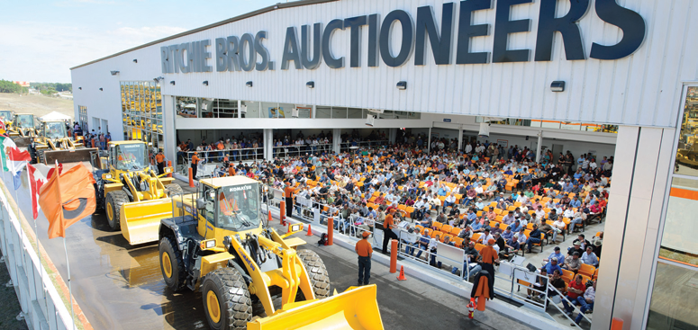
E-procurement
Vertical hubs
Functional hubs
Direct extranet links to major suppliers
Buying alliances
Company buying sites
Notes:
Web sites are organized around two types of e-hubs: vertical hubs centered on industries (plastics, steel, chemicals, paper) and functional hubs (logistics, media buying, advertising, energy management).
Set up direct extranet links to major suppliers. A company can set up a direct e-procurement account at Dell or Office Depot, for instance, and its employees can make their purchases this way.
Form buying alliances. A number of major retailers and manufacturers such as Acosta, Ahold, Best Buy, Carrefour, Family Dollar Stores, Lowe’s, Safeway, Sears, SUPERVALU, Target, Walgreens, Walmart, and Wegmans Food Markets are part of a data-sharing alliance called 1SYNC. Several auto companies (GM, Ford, Chrysler) formed Covisint for the same reason.
Set up company buying sites. General Electric formed the Trading Process Network (TPN), where it posts requests for proposals (RFPs), negotiates terms, and places orders.

Slide 13
Stages in the Buying Process
Proposal solicitation
  The buyer next invites qualified suppliers to submit written proposals
Supplier selection
  Before selecting a supplier, the buying center will specify and rank desired supplier attributes
Notes:
After evaluating proposals, the buyer will invite a few suppliers to make formal presentations. The choice of attributes and their relative importance vary with the buying situation. Delivery reliability, price, and supplier reputation are important for routine-order products.

Slide 14
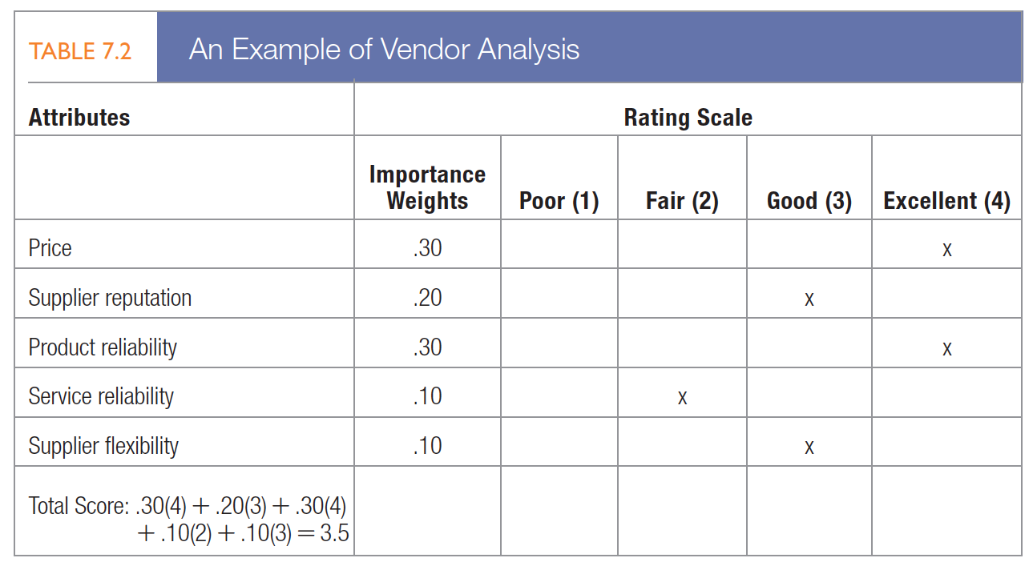
A supplier-evaluation model
Notes:
To develop compelling value propositions, business marketers need to better understand how business buyers arrive at their valuations. Researchers have identified eight different customer value assessment (CVA) methods. Companies tended to use the simpler methods, though the more sophisticated ones promise a more accurate picture of CPV (see “Marketing Memo: Developing Compelling Customer Value Propositions”).

Slide 15
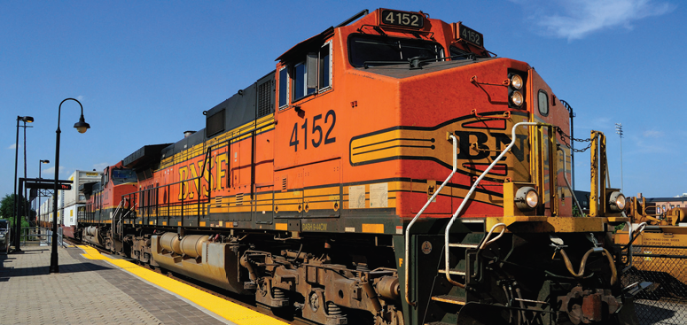
Supplier selection
Overcoming price pressures
  Solution selling
  Risk and gain sharing
Number of suppliers
Notes:
Despite moves toward strategic sourcing, partnering, and participation in cross-functional teams, buyers still spend a large chunk of their time haggling with suppliers on price.
Despite moves toward strategic sourcing, partnering, and participation in cross-functional teams, buyers still spend a large chunk of their time haggling with suppliers on price.
Solution selling can also alleviate price pressure and comes in different forms. Here are three examples.
Solutions to enhance customer revenues. Hendrix UTD has used its sales consultants to help farmers deliver an incremental animal weight gain of 5 percent to 10 percent over competitors.
Solutions to decrease customer risks. ICI Explosives formulated a safer way to ship explosives for quarries.
Solutions to reduce customer costs. W. W. Grainger employees work at large customer facilities to reduce materials-management costs.
Risk and gain sharing can offset price reductions customers request.
Companies are increasingly reducing the number of their suppliers. Ford, Motorola, and Honeywell have cut their number of suppliers 20 percent to 80 percent. These companies want their chosen suppliers to be responsible for a larger component system, achieve continuous quality and performance improvement, and at the same time lower prices each year by a given percentage. They expect their suppliers to work closely with them during product development, and they value their suggestions.

Slide 16
Stages in the Buying Process
Order-routine specification
  After selecting suppliers, the buyer negotiates the final order, listing the technical specifications, the quantity needed, the expected time of delivery, return policies, warranties, etc.
Performance review
  The buyer periodically reviews the performance of the chosen supplier(s)
Notes:
The lessee gains a number of advantages: the latest products, better service, the conservation of capital, and some tax advantages. The lessor often ends up with a larger net income and the chance to sell to customers that could not afford outright purchase.
The buyer may contact end users and ask for their evaluations, rate the supplier on several criteria using a weighted-score method, or aggregate the cost of poor performance to come up with adjusted costs of purchase, including price. The performance review may lead the buyer to continue, modify, or end a supplier relationship.

Slide 17

Developing Effective b2b Marketing Programs
Communication and branding activities
Systems buying and selling
  Total problem solution from one seller (turnkey solution)
Role of services
Notes:
Business marketers are increasingly recognizing the importance of their brand. In business-to-business marketing, the corporate brand is often critical because it is associated with so many of the company’s products. Some business-to-business marketers are adopting marketing practices from business-to-consumer markets to build their brand.
Many business buyers prefer to buy a total problem solution from one seller. Called systems buying, this practice originated with government purchases of major weapons and communications systems. The government solicited bids from prime contractors that, if awarded the contract, became responsible for bidding out and assembling the system’s subcomponents from second-tier contractors. The prime contractor thus provided a turnkey solution, so-called because the buyer simply had to turn one key to get the job done.
Services play an increasing strategic and financial role for many business-to-business firms selling primarily
products. Adding high-quality services to their product offerings allows them to provide greater value and establish closer ties with customers.

Slide 18
Buyer–supplier relationships
Basic buying and selling
Bare bones
Contractual transaction
Customer supply
Cooperative systems
Collaborative
Mutually adaptive
Customer is king
Notes:
A number of forces influence the development of a relationship between business partners. Four relevant ones are availability of alternatives, importance of supply, complexity of supply, and supply market dynamism. Based on these we can classify buyer–supplier relationships into eight categories:
1. Basic buying and selling—These are simple, routine exchanges with moderate levels of cooperation and information exchange.
2. Bare bones—These relationships require more adaptation by the seller and less cooperation and information exchange.
3. Contractual transaction—These exchanges are defined by formal contract and generally have low levels of
trust, cooperation, and interaction.
4. Customer supply—In this traditional supply situation, competition rather than cooperation is the dominant
form of governance.
5. Cooperative systems—The partners in cooperative systems are united in operational ways, but neither demonstrates structural commitment through legal means or adaptation.
6. Collaborative—In collaborative exchanges, much trust and commitment lead to true partnership.
7. Mutually adaptive—Buyers and sellers make many relationship-specific adaptations, but without necessarily achieving strong trust or cooperation.
8. Customer is king—In this close, cooperative relationship, the seller adapts to meet the customer’s needs without expecting much adaptation or change in exchange.

Slide 19
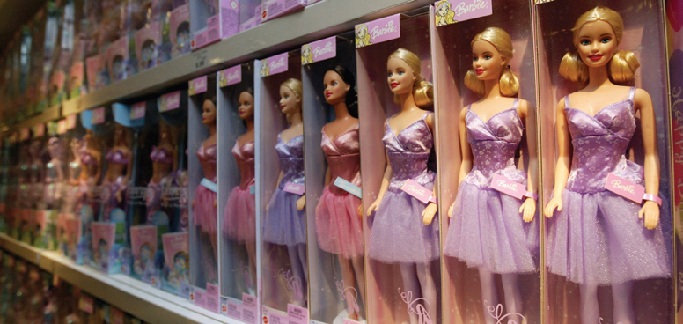
MANAGING B2B
CUSTOMER RELATIONSHIPS
Risks and Opportunism in Business Relationships
Notes:
Vertical coordination can facilitate stronger customer–seller ties but may also increase the risk to the customer’s and supplier’s specific investments. Specific investments, however, also entail considerable risk to both customer and supplier. Transaction theory from economics maintains that because these investments are partially sunk, they lock firms into a particular relationship. Sensitive cost and process information may need to be exchanged. A buyer may be vulnerable to holdup because of switching costs; a supplier may be more vulnerable because it has dedicated assets and/or technology/knowledge at stake.
When buyers cannot easily monitor supplier performance, the supplier might shirk or cheat and not deliver the expected value. Opportunism is “some form of cheating or undersupply relative to an implicit or explicit contract. Opportunism is a concern because firms must devote resources to control and monitoring that they could otherwise allocate to more productive purposes.

Slide 20
Institutional and Government Markets
Institutional market
  Schools, hospitals, nursing homes, prisons, etc. that must provide goods and services to people in their care
Government organizations
  Are a major buyer of goods and services in most countries
Notes:
Many institutions are characterized by low budgets and captive clienteles. Government organizations typically require suppliers to submit bids and often award the contract to the lowest bidder, sometimes making allowance for superior quality or a reputation for completing contracts on time. Governments will also buy on a negotiated-contract basis, primarily in complex projects with major R&D costs and risks and those where there is little competition.

Slide 21
